Slide 1
Clearing the figure window
You can clear the plot window by typing clf which stands for 'clear figure' . to get rid of a figure window entirely , type close .to get rid of all the figure windows , type close all . new figure windows can be created by typing figure.
Subplots
To plot more than one set of axes in the same window , use the subplot command . you can type
Subplot(m,n,p)
To break up the plotting window into m plots in the vertical direction and n plots in the horizontal direction , choosing the pth plot for drawing into. The subplots are counted as you read text :left to right along the top row , then left to right along the second row, and so on . here is an Example

Slide 2
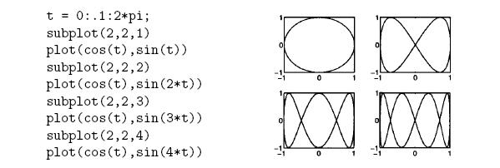

Slide 3
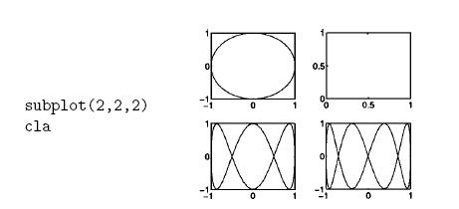
If you want to clear one of the plots in a subplot without affecting the others you can use
the cla (clear axes) command . continuing the previous example :

Slide 4
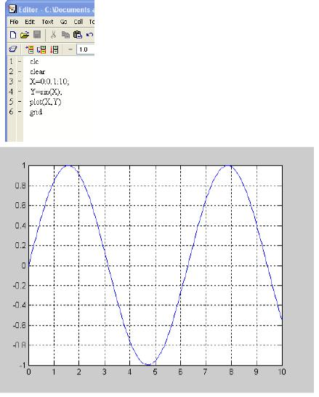

Slide 5
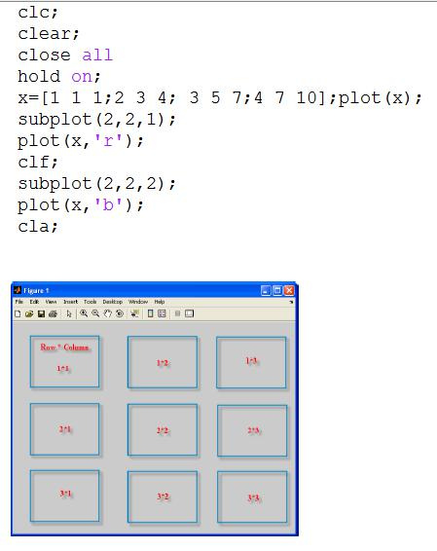
Try following example:-

Slide 6
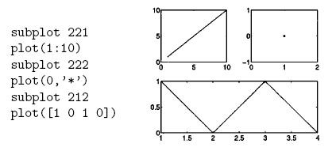

Slide 7
Three dimension plots
The plot3 command is the 3-d equivalent of plot:
The three dimensional spiral can be better visualized by changing the orientation of the axes
, you can invoke a mouse – base 3-d axis mover by typing: rotate3
If you click the mouse button down on the plot and drag , you can move the axes and
view the plot from any angle . release the mouse button to redraw the data. Type rotate3 again
to turn off this behaviour.

